Slide 1


Slide 2
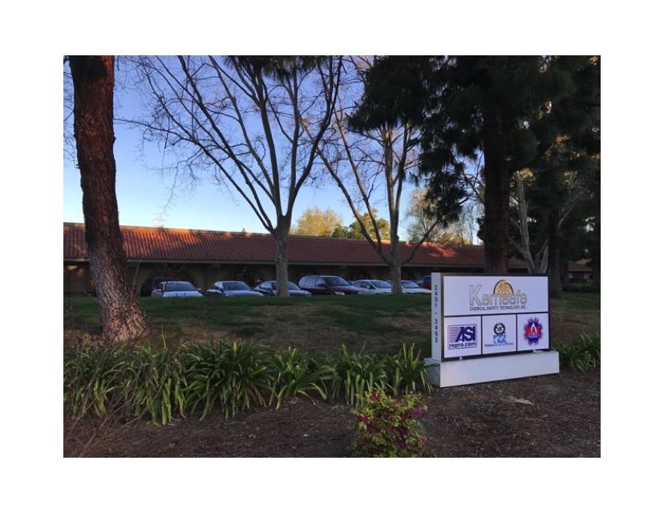
NSi Facility
Located in the heart of Silicon Valley San Jose, California.
NanoSILICON, Inc. was founded in 2010.

Slide 3
Organizational Chart
5.3
Jackie Bejan
President & CEO
Cheryl Oldham
Admin
Rafael Corona
Day Supervisor
Armando Barriga
Cleanroom QC
Michelle Piffero
Bus. Dev. & Quality Manager
Pablo Arroyo
Day Supervisor
Enrique Macias
Night Supervisor
Production & Facilities
Administration & Management
Ubaldo Macias
Maintenance & Facilities
Lincoln Bejan
VP of Engineering
Regga Teska Process Engineer
Facility #1, 9,400 sqft *
Facility #2, 5,440 sqft *
Approximately 28 Employees*

Slide 4
NSi Product Offerings
Silicon Reclaim Services: 50.8mm Through 300mm Diameters
Silicon Wafer Sales: 50.8mm Through 300mm Diameters
Virgin Test, Virgin Prime, Reclaim Grade
Semi Standard And Custom Wafer Specifications
Thermal Oxide And Other Thin Film Deposition
Metrology: ADE, KLA-Tencor 6220, Nanometrics 210
Alternative Substrates: Borofloat, Quartz, Fused Silica
Inventory Management And Consignment
Laser Cut Down - Edge Profiling - Laser Scribe
Cassette And FOUP Cleaning, Destruction Of Scrap, R & D Services

Slide 5
NSi Reclaim Capabilities
Film Strip / Etch
  Metal And Non-Metal Films
  Separate Metal And Non-Metal Lines To Prevent Contamination
Polish / Lap / Etch
Laser Scribe
Class 100 Clean Room
Metrology
  Type, Resistivity, Orientation, Particle Counting to ≤30@0.16µm
Specification Binning
Full Final Disposition For Wafer Accountability

Slide 6
NSi Process Flow
Reclaim
Virgin Test & Prime
Receive
Customer Supplied Material
Sort
Metals
Non-Metals
Strip
Metals Strip
Non-Metals Strip
Polish
Other Categories/Binning
RCA Clean (SC1 and SC2)
Clean
Stock Removal
Final Polish
Inspection/QC Bliss
Packaging
Visual ≤15@0.5µm
KLA-Tencor 6220 ≤30@0.16µm
Desiccant
Poly &/or Foil bags
Unique Reclaim Lot ID Issued
Spec Verification & WPO Submission
Scrub
Megasonic
Receive
Virgin Starting Material
Polish
RCA Clean (SC1 and SC2)
Clean
Stock Removal
Final Polish
Inspection/QC Bliss
Packaging
Visual ≤15@0.5µm
KLA-Tencor 6220 ≤30@0.16µm
Desiccant
Poly &/or Foil bags
Unique Virgin Lot ID
Spec Verification & WPO Submission
Megasonic
Scrub

Slide 7
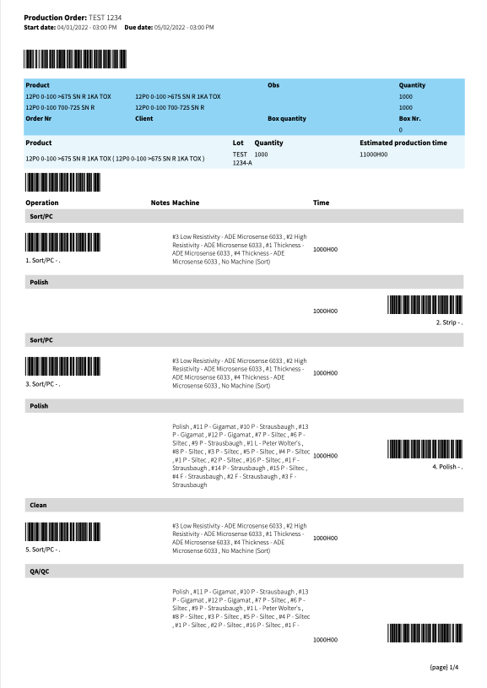
NSi Customer Lot Integrity
Unique Traveler And Lot ID Per Specification
Traveler Accompanies Wafers Throughout Production
Production Alternates Diameters With Every Lot Change
Each Department Records Yields And Approves Traveler Before Passing To The Next Production Step
QA Checks, Guarantees, And Applies A Final QA Sticker Signifying Specification Compliance

Slide 8
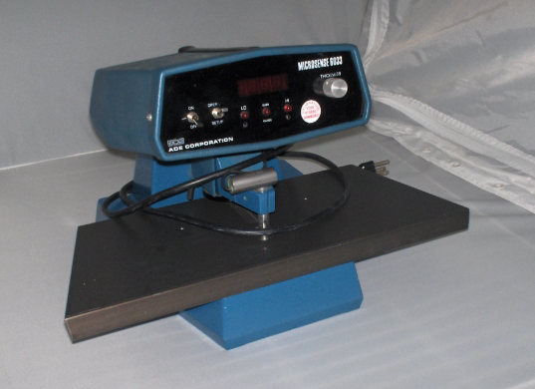
NSi Metrology Tools
ADE Microsense 6033
Indicates Thickness, Resistivity, & TTV
Nanometrics 210
Verifies Oxide Film Thickness And Uniformity
KLA Tencor Surfscan 6220
Maps Defects And Particles

Slide 9
NSi Sales By Diameter

Slide 10
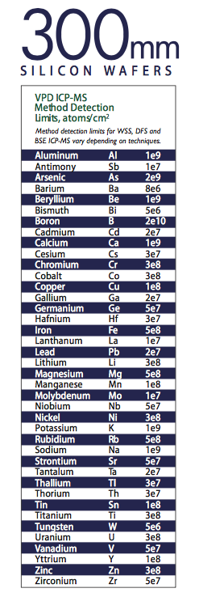
NSi Metals Policy
ChemTrace Quarterly Metals Analysis
VPD ICP-MS Method
  Vapor Phase Decomposition Inductively Coupled Plasma – Mass Spectroscopy
Thirty Different Elements Tested
Focus On Nine Elements Important To The Semiconductor Industry
NSi Metals Data:
Copper Cu <1E10
Chromium Cr <5E10
Iron Fe <5E10
Nickel Ni <5E10
Calcium Ca <5E10
Sodium Na <5E10
Zinc Zn <5E10
Aluminum Al <5E10
Potassium K <5E10

Slide 11
NSi ISO 9001:2015 Timeline
  2021
  Signed On With Perry Johnson Registrar
  Implement All Inclusive ERP, CRM, WIP, And QMS Software System
  2022
  Q2 Perry Johnson Gap Analysis
  Q3 Perry Johnson Internal ISO Audit
  Q4 Perry Johnson Certification Audit

Slide 12
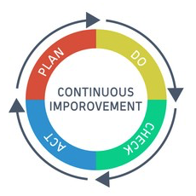
NSi Quality Policy

Slide 13

NSi EHS Policy

Slide 14

NSi BCP And CSR
Business Continuity Plan
Secondary Backup Tools
Duplicate Facility
Adequate Insurance Coverage
For All NSi Tools, Consumables, And Inventory
Corporate Social Responsibility
Recycle Programs For E-waste, Plastics, And All Regular Waste
Wet Scrubber System Surpasses Emission Standards Allowing Bay Area Air Quality Management District To Grant Permit Exemption
Clean Harbors Collects All Hazardous Materials In Lieu Of Neutralizing In House And Eliminating Through The POTW System

Slide 15
NSi Summary
NanoSILICON, Inc. is interested in becoming your wafer vendor, with the focus on following your lead.
NanoSILICON, Inc. is a service driven entity and understands today’s high demand to remain flexible with our customers.
We will be price competitive and will not compromise our quality standards for the sake of market share.
Thank you for your time. We look forward to working with you.

